Slide 1
State Elements
Appendix B
Some info from:
http://cse.yeditepe.edu.tr/~ayildiz/attachments/flipflops.pdf

Slide 2
Clock
The clock is a signal generated that coordinates the timing of operations within the processor

Slide 3
Asserted vs. Deasserted
It might feel natural to consider :
Asserted = 1= High
Deasserted = 0 = Low
However, for some architectures 0=Asserted. We will use the convention that Asserted = 1 and Deasserted = 0.

Slide 4
Clocked vs. Unclocked
Clocked elements will change value depending on an input from a clock
Unclocked elements will change value when inputs are asserted or deasserted regardless of the clock state

Slide 5
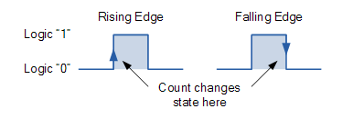
Clock Edge
The clock edge occurs when the clock signal transitions from asserted to deasserted

Slide 6
State Components
So far, we’ve discussed circuits:
Electricity flows via wires and gates and produces an output depending on logic depicted in a truth table.
These circuits do not hold a value for any amount of time.

Slide 7
State Components
A State Component is a circuit designed in such a way that it will change on a clock cycle.
A Component is “clocked” if the clock signal is an input. Otherwise, the component is “unclocked”

Slide 8
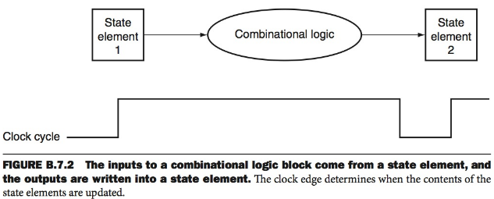
State Components w/ Combinational Logic

Slide 9
Latch vs. Flip Flop
Latch – Contents stored changes according the inputs when Clock is asserted
Flip Flop – Contents stored changes when Clock changes from asserted to deasserted and vice versa.

Slide 10
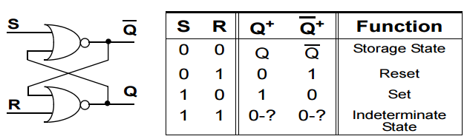
S-R (set – reset) Latch
Q is our output…
“Set” asserted means output is 1
“Reset” asserted means output is zero

Slide 11
S-R (set – reset) Latch
When Set and Reset are not asserted, output
Is whatever was stored in the S-R Latch
If S and R differ, Q is set to zero if S is 0, 1 if S
Is 1.
S=R=1 is undefined.

Slide 12
Memory: S-R Latch
Unclocked– Does not need clock to change it’s stored value
The two inputs need to be asserted in a certain combination or else it is unstable
Can not assert Sand R at the same time b/c deasserting may cause it to become unstable

Slide 13
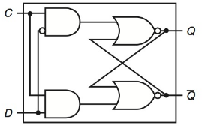
D Latch
D: Data Input C: Control aka Clock
When the clock is high, Q = what is on D
Otherwise, it’s what was on D last time C was high.

Slide 14
D Flip-Flop
D Flip-Flops are used to implement Registers in MIPS
A set of n D Flip-Flops are used to store n bits of information.
D stands for Data or Delay

Slide 15
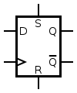
D Flip-Flop
The Q output always takes on the state of the D input at the moment of a rising clock edge. (or falling edge if the clock input is active low)^{[2]}
It is called the D flip-flop for this reason, since the output takes the value of the D input or Data input, and Delays it by one clock count.
The D flip-flop can be interpreted as a primitive memory cell, zero-order hold, or delay line.
http://en.wikibooks.org/wiki/Electronics/Latches_and_Flip_Flops

Slide 16
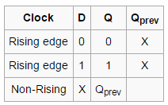
D Flip-Flop Truth Table

Slide 17
Other Flip-Flops
JK
Toggle
RS

Slide 18
Minimum Clock Cycle
Inputs to a State Element are read on a clock edge
They sometimes come from a Combinational Logical Circuit
Imagine all of the inputs in the Combinational Circuit travelling through the gates to the output line.
The Cycle must allow enough time for the gates to perform their logic so that the outputs are stable

Slide 19
Register File
A collection of n-bit registers
IN
Register number represented in a number of bits
OUT
Contents of register

Slide 20
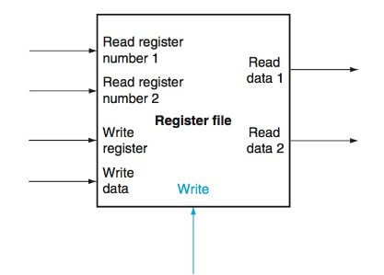
Register File

Slide 21
Register File Operation: Read
IN: Register Number
OUT: Data in Register

Slide 22
Register File Operation: Write
IN: Register to Write From(5)
IN: Register to Write To (5)
IN: Data (32)

Slide 23
Accessing a Register
Exercise:
Create a truth table for a Combinational Component that has three inputs and eight outputs.
The output with position equal to binary value coming in should be high. All others must be low

